Slide 1
Detection of IoT Botnet Attacks
Chinmayi C. Ramakrishna
Priyanka B. G.
K. Keerthana
(181IT113)
(181IT135)
(181IT221)

Slide 2

Objectives
Heterogeneity Tolerance: Accommodates growing diversity of IoT devices.
Real world: Detects abnormal behaviour rather than classification.
Efficiency: Semi online training of autoencoders is used to improve storage efficiency.
Extracts behavior snapshots of the network
Use auto encoders as a complete means of botnet detection.
Use real traffic to perform analysis

Slide 3
Summary of the paper
Extracts behavior snapshots of the network
Uses deep autoencoders to detect anomalous network traffic from compromised IoT devices.
Infected nine commercial IoT devices in lab setup with two widely known IoT-based botnets, Mirai and BASHLITE.
The autoencoders attempt to compress snapshots. When an autoencoder fails to reconstruct a snapshot, it is a strong indication that the observed behavior is anomalous.
Uses real traffic data and not simulated ones.

Slide 4
Dataset
The data was obtained experimentally in a laboratory environment by the research team at Ben-Gurion University of Negev .
The data comes from 9 IoT devices belonging to smart-home and security domains: doorbells, security cameras, thermostat, baby monitor.
In total dataset consists of more than 5 million points.
Data set will be split into train and test subsets as 80:20

Slide 5
Algorithm used
Anomaly detection is done using autoencoder.
Autoencoder consists of 5 hidden layers.
Deep Neural Network is used for attack classification.
Deep neural network consists of two hidden layers each with 8 neurons.
Hyperbolic tangent activation function for hidden neurons.
Softmax function applied to the last layer.

Slide 6
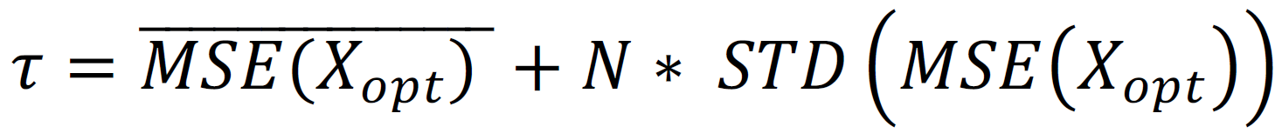
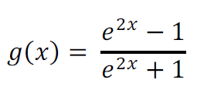
Novelty
The datasets for different devices will be combined into one
Autoencoder algorithm as described in the paper will be implemented for this dataset.
A parameter will be added to the threshold formula and an optimization is made for this parameter.
Activation function choice and optimization algorithm choice.

Slide 7

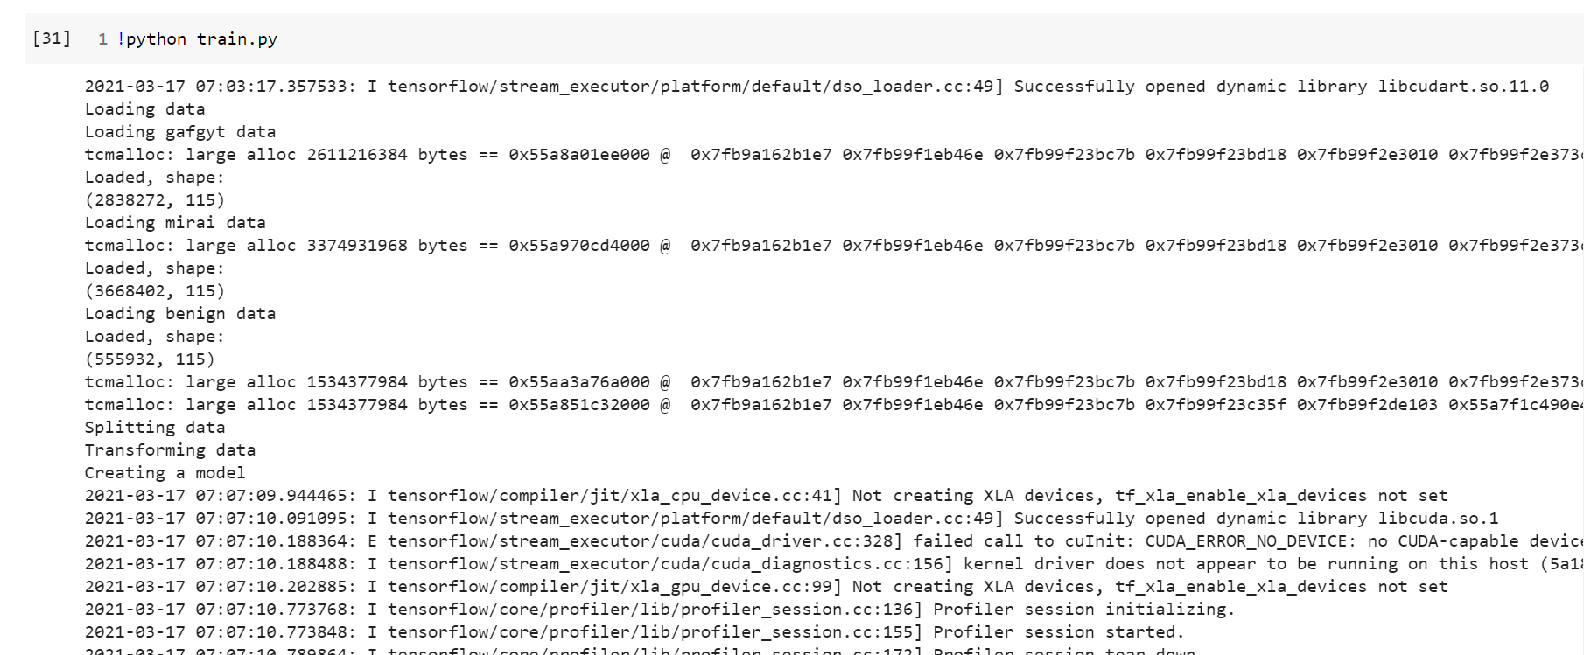
Screenshots

Slide 8
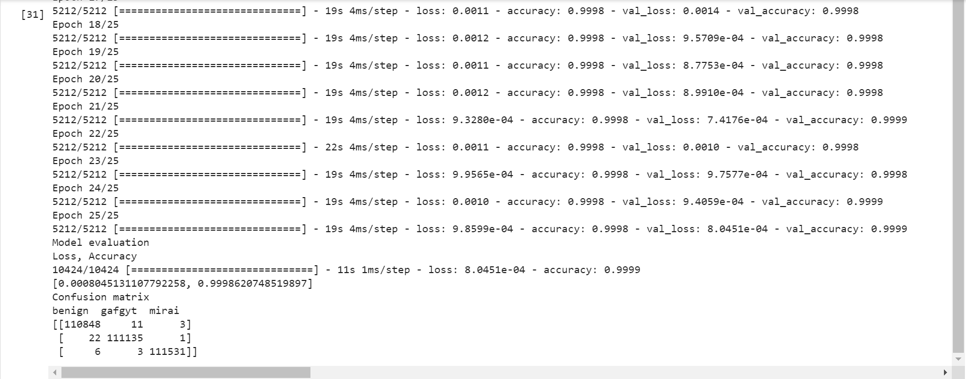
Screenshots

Slide 9
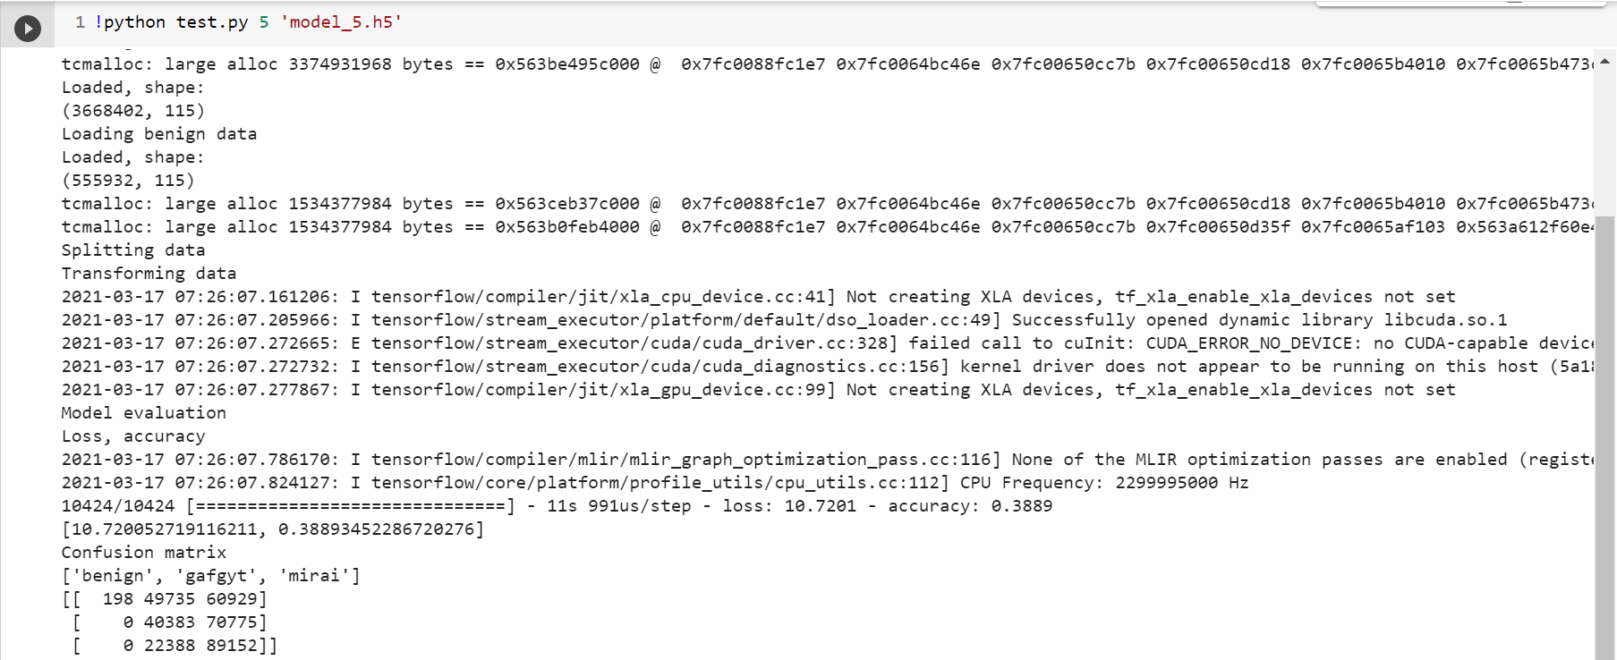
Screenshots

Slide 10
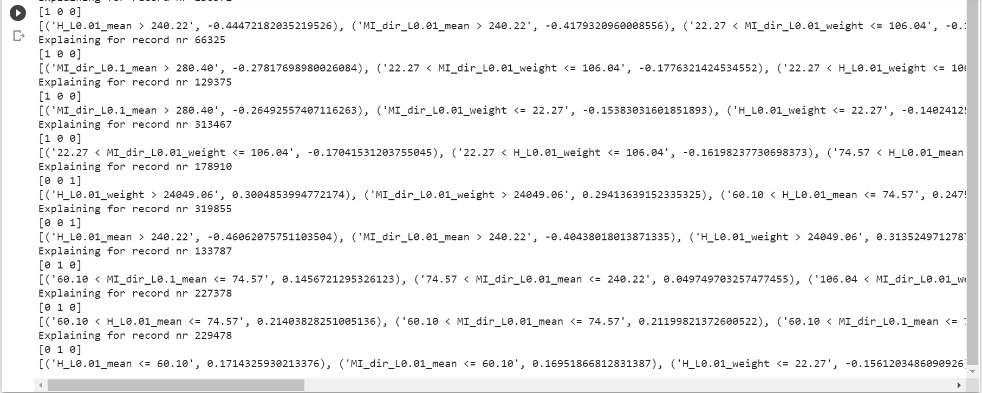
Screenshots

Slide 11
References
Y. Meidan, et al , "iot botnet dataset," [Online]. Available: https://archive.ics.uci.edu/ml/datasets/detection_of_IoT_botnet_attacks_N_BaIoT. [Accessed 27 December 2018].

